Slide 1
Delivering your APpLes
or...
7 Deployments in 7×5 Minutes
Morten Kromberg CTO, Dyalog Limited

Slide 2
7 Deployments in 7x5 minutes
Full Stack in APL
Interactive APL Session
Win32 GUI "Stand Alone Executable"
Cross-Platform GUI (Desktop AND Web)
Embedded APL Components
Shared Library (called from Python)
Microsoft.NET Assembly (called from PowerShell)
Services
Web Service in Docker Container (called from curl)
Serverless Lambda (Amazon Web Services)

Slide 3
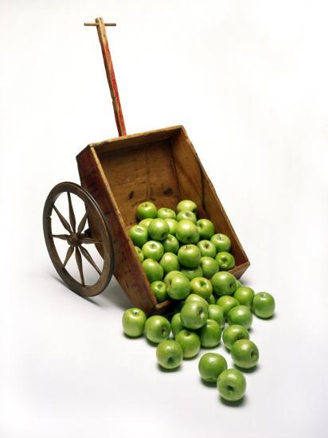
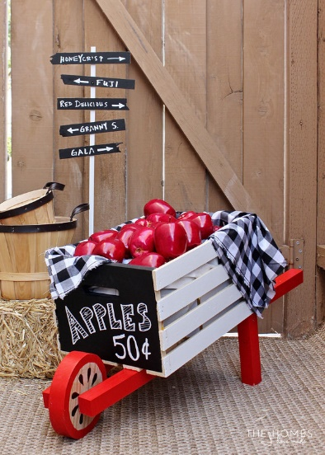
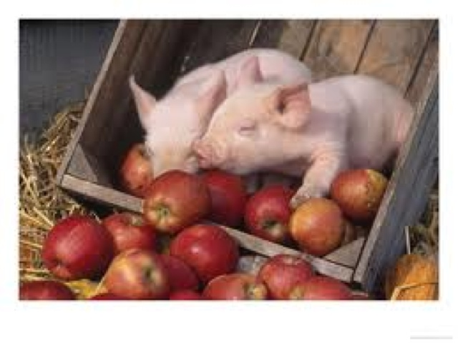
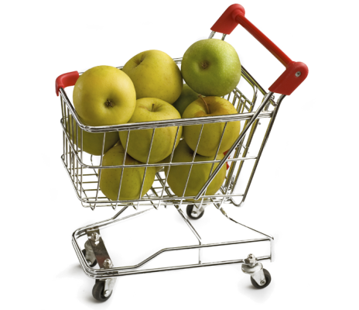
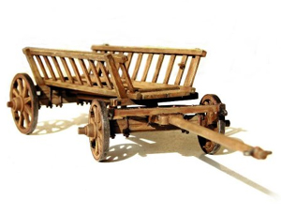
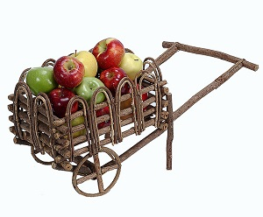


Slide 4
But First some fun: Volutions
iv 5
1 2 3 4 5 16 17 18 19 6 15 24 25 20 7 14 23 22 21 8 13 12 11 10 9
iv
{⍵ ⍵⍴⍋+\(1↓2/⌽⍳⍵)/(¯1+2×⍵)⍴(+,-)1 ⍵}
→ → → → → ↑ → → → ↓ ↑ ↑ → ↓ ↓ ↑ ← ← ↓ ↓ ← ← ← ← ↓
5
4
4
3
3
2
2
1
1
5 5
Grade Running Total
1 5 ¯1 ¯5
9
5 4 4 3 3 2 2 1 1

Slide 5
Involution, explained
iv 5 indices
1 2 3 4 5 1 2 3 4 5 16 17 18 19 6 6 7 8 9 10 15 24 25 20 7 11 12 13 14 15 14 23 22 21 8 16 17 18 19 20 13 12 11 10 9 21 22 23 24 25
iv←{⍵ ⍵⍴⍋+\(1↓2/⌽⍳⍵)/(¯1+2×⍵)⍴(+,-)1 ⍵}
involute←{
directions←(+,-) 1 ⍵
moves←(¯1+2×⍵)⍴directions
repeat←1↓2/⌽⍳⍵
allmoves←repeat/moves
path←+\allmoves
⍵ ⍵⍴⍋path
}
1 5 ¯1 ¯5
1 5 ¯1 ¯5 1 5 ¯1 ¯5 1
5 4 4 3 3 2 2 1 1
1 1 1 1 1 5 5 5 5 ¯1 ¯1 ¯1 ¯1 ¯5 ...
1 2 3 4 5 10 15 20 25 24 23 22 21 14 ...
1 2 3 4 5 16 17 18 19 6 15 24 25 20 ...
iv←{⍵ ⍵⍴⍋+\(1↓2/⌽⍳⍵)/(¯1+2×⍵)⍴(+,-)1 ⍵}

Slide 6
7 Deployments in 7x5 minutes
Full Stack in APL
Interactive APL Session
Win32 GUI "Stand Alone Executable"
Cross-Platform GUI (Desktop or Web)
Embedded APL Components
Shared Library (called from Python)
Microsoft.NET Assembly (called from PowerShell)
Services
Web Service in Docker Container (called from curl)
Serverless Lambda (Amazon Web Services)

Slide 7

1. Interactive APL Session
Dyalog APL for Windows
Just using the REPL
Deploy by "saving" a workspace

Slide 8
2. Win32 GUI "Stand-Alone Executable"
Under Windows, Dyalog APL includes a Win32 object library, tightly integrated with APL
File|Save As|Stand-Alone Executable bundles the interpreter and APL source into a single executable file

Slide 9
3. Cross-Platform GUI (Desktop or Web)
Since version 17.0 (2018), Dyalog APL wraps the Chromium Embedded Framework on all platforms except IBM AIX
Windows, macOS, Linux (Intel and ARM)
A library of APL classes to generate HTML/JS is available (and some users roll their own)
The same UI generation tools can be used to create web servers.

Slide 10
APL Embedded
The first three examples used Dyalog APL "out of the box" and no other components
The next 2 are examples of different ways to embed APL engines into other tools
Shared Library (called from Python)
Microsoft.NET Assembly (called from PowerShell)

Slide 11
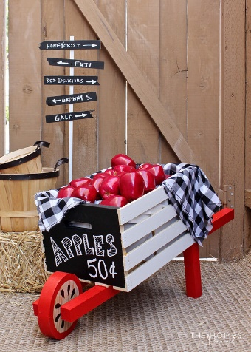
4. Shared Library
We provide a framework which makes it simple to call APL from C
This allows you to you to easily create a shared library and call APL from it
A pre-compiled library called JSON_APL is included on all platforms, it exposes a couple of functions which take string arguments:
Load APL code into the engine
Call APL functions using JSON to represent arguments and results
In our example we will call this from Python...

Slide 12
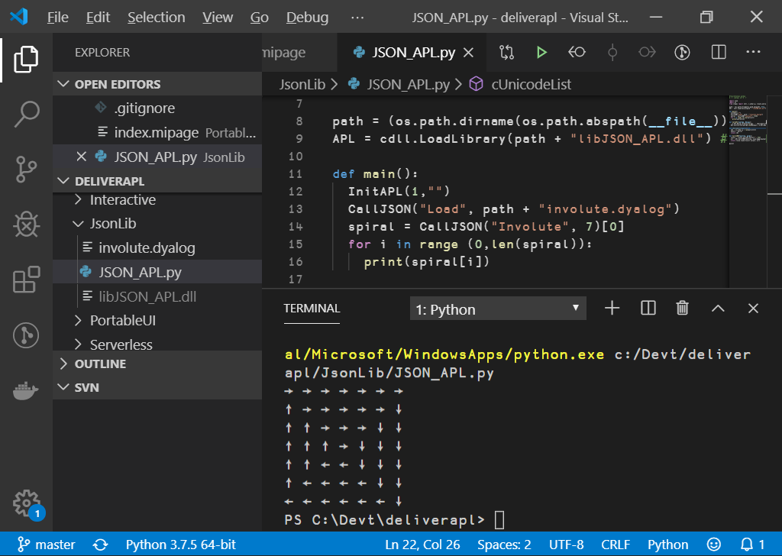

Slide 13
5. Microsoft.NET Assembly
Dyalog APL has supported Object Oriented programming since Microsoft.NET v1.0
Applications can make use of .NET libraries, and also generate .NET assemblies
Including writing APL classes which inherit from C# classes or any other .NET language
We will generate a .NET assembly and call it from Powershell…

Slide 14
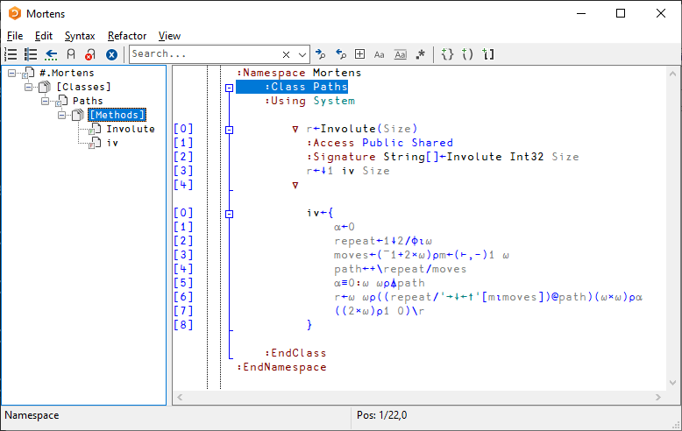

Slide 15
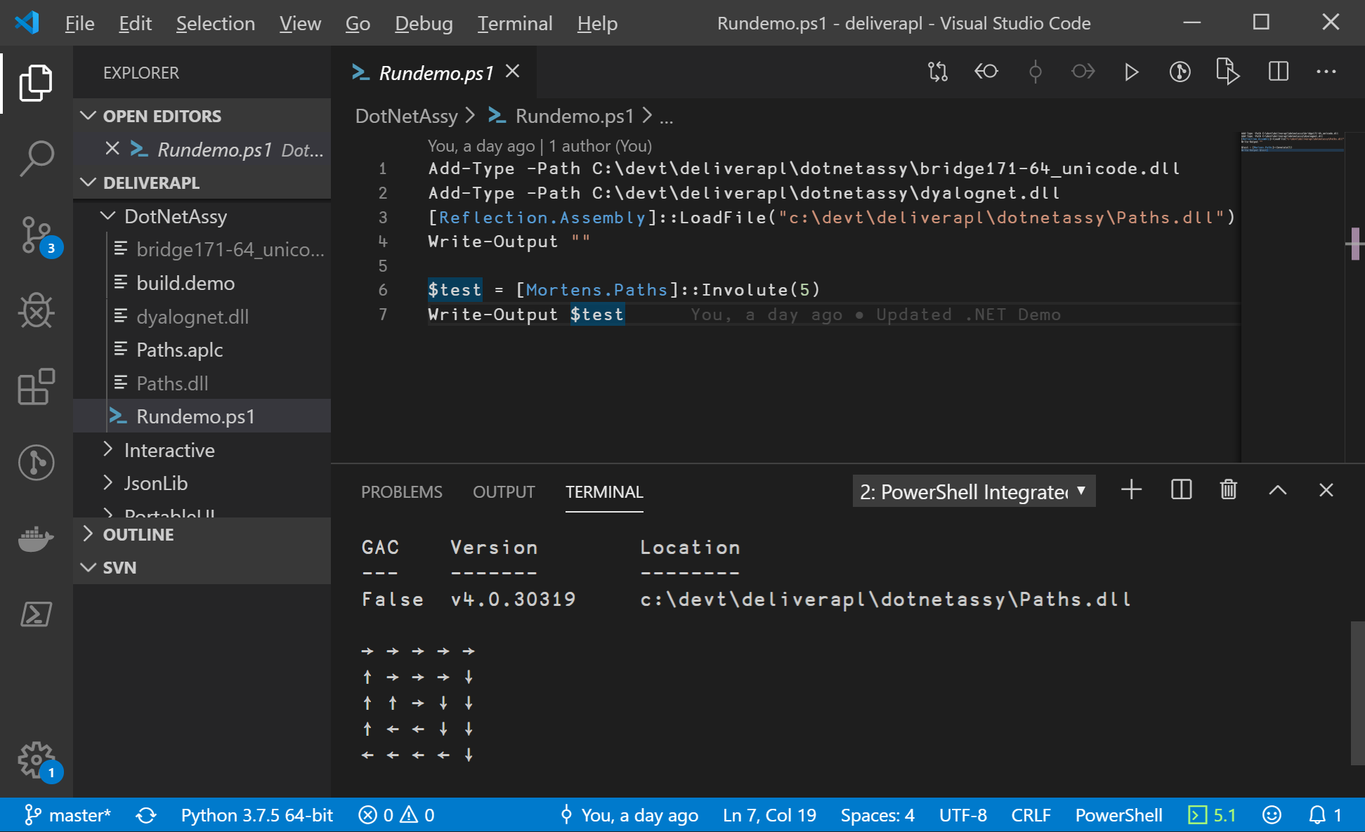

Slide 16
Services
Finally, we will look at 2 examples of services:
Web Service in Docker Container (called from curl)
Serverless Lambda (Amazon Web Services)

Slide 17
6. Web Service in Docker Container
Dyalog provides a number of pre-built Linux containers, containing:
Dyalog APL only
APL with MiServer (web server framework)
APL with JSONServer (web services)
APL with Jupyter Notebook server for educational apps
In each of these containers, the framework will look for a folder called /code and use it as the application
We will use the dyalog/jsonserver image to expose a simple web service

Slide 18
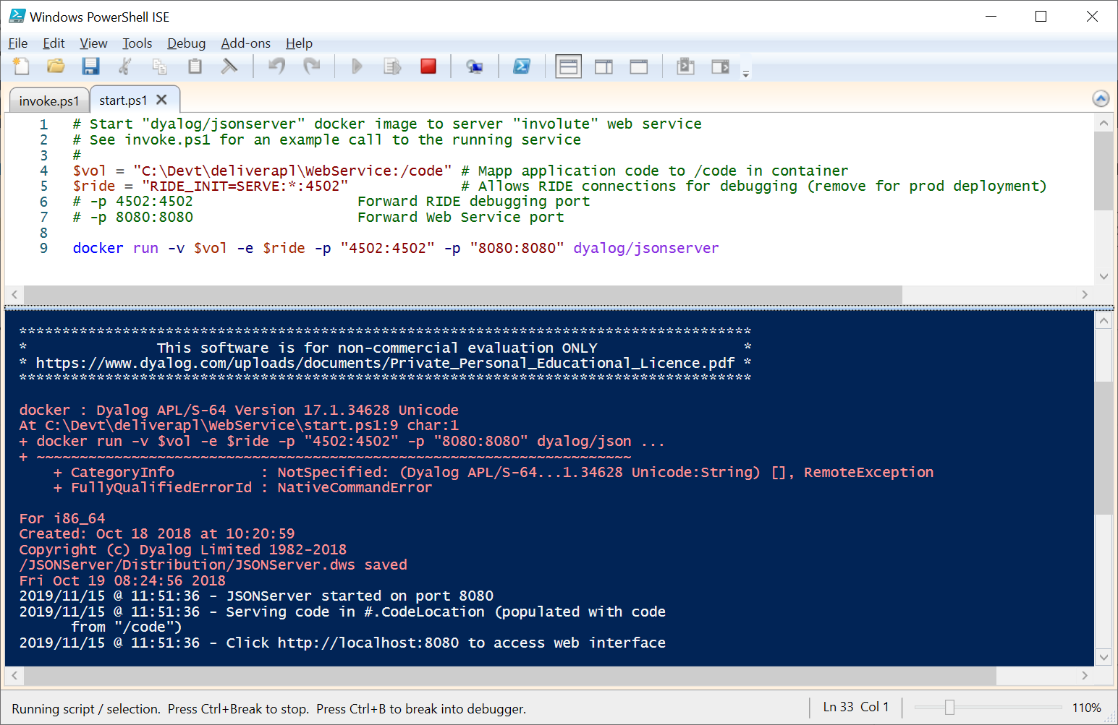

Slide 19
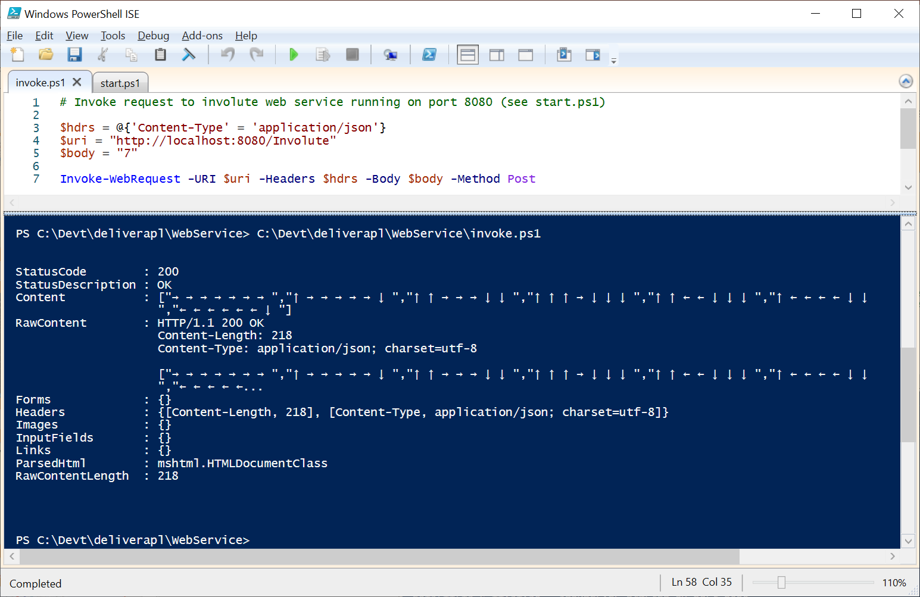

Slide 20
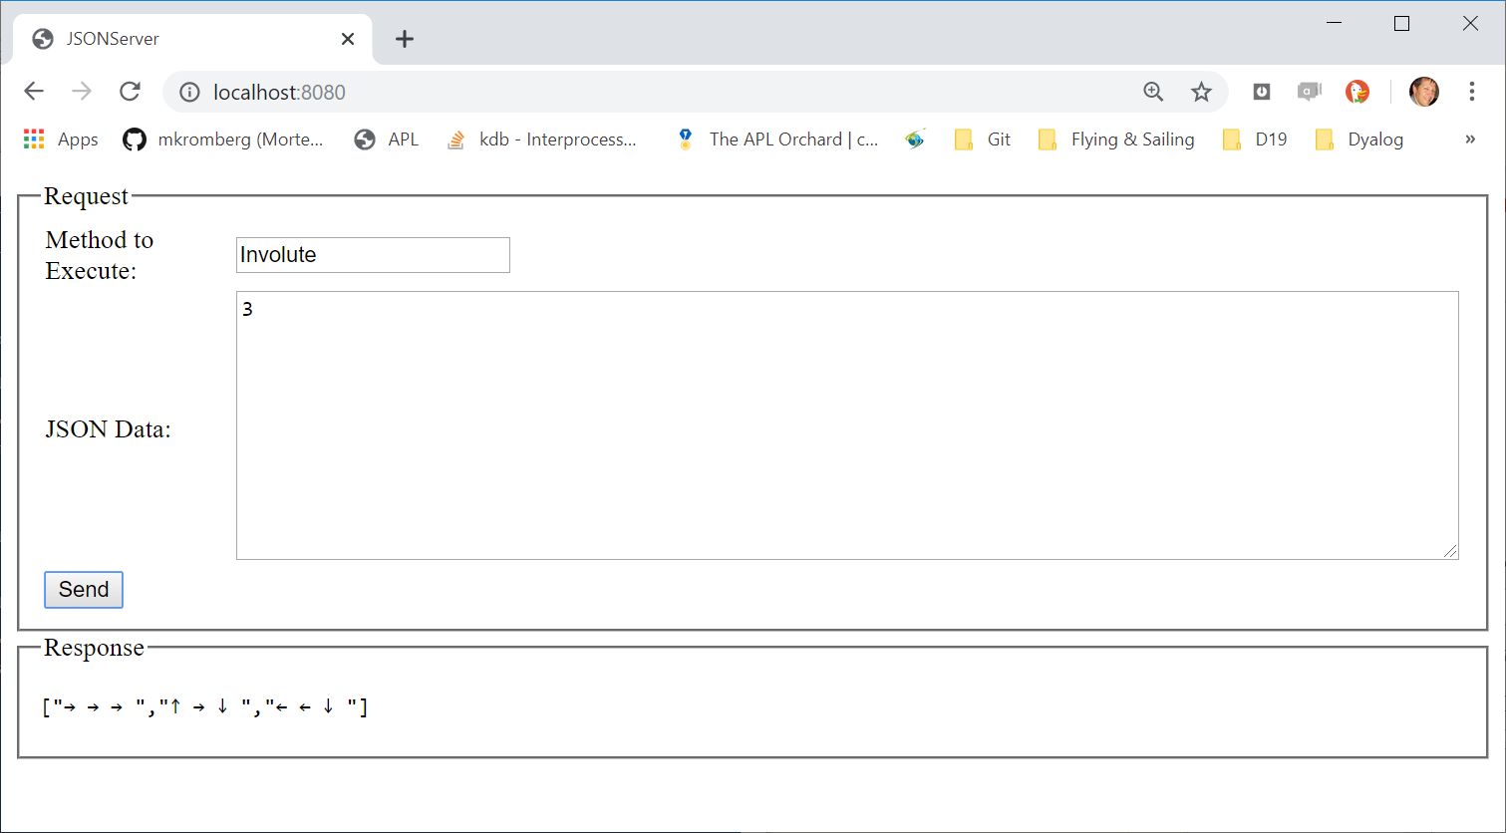
JSONServer also exposes a simple test page

Slide 21
7. Serverless (Amazon Web Sevices Lambda)
APL AWS layer at https://github.com/mvranic/apl-lambda is based on https://github.com/lambci/node-custom-lambda by Marko Vranic from SimCorp A/S.
The rest is easy…

Slide 22
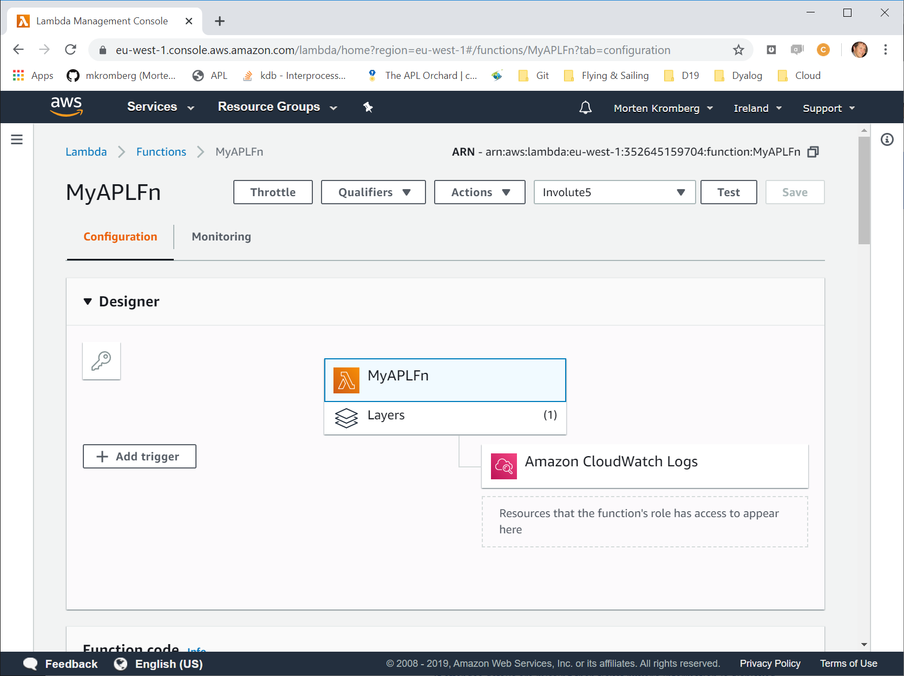

Slide 23
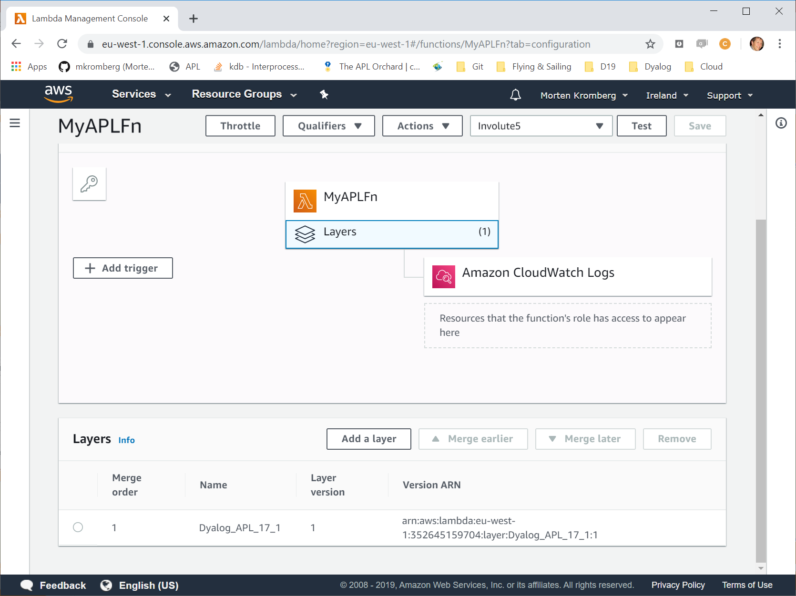

Slide 24
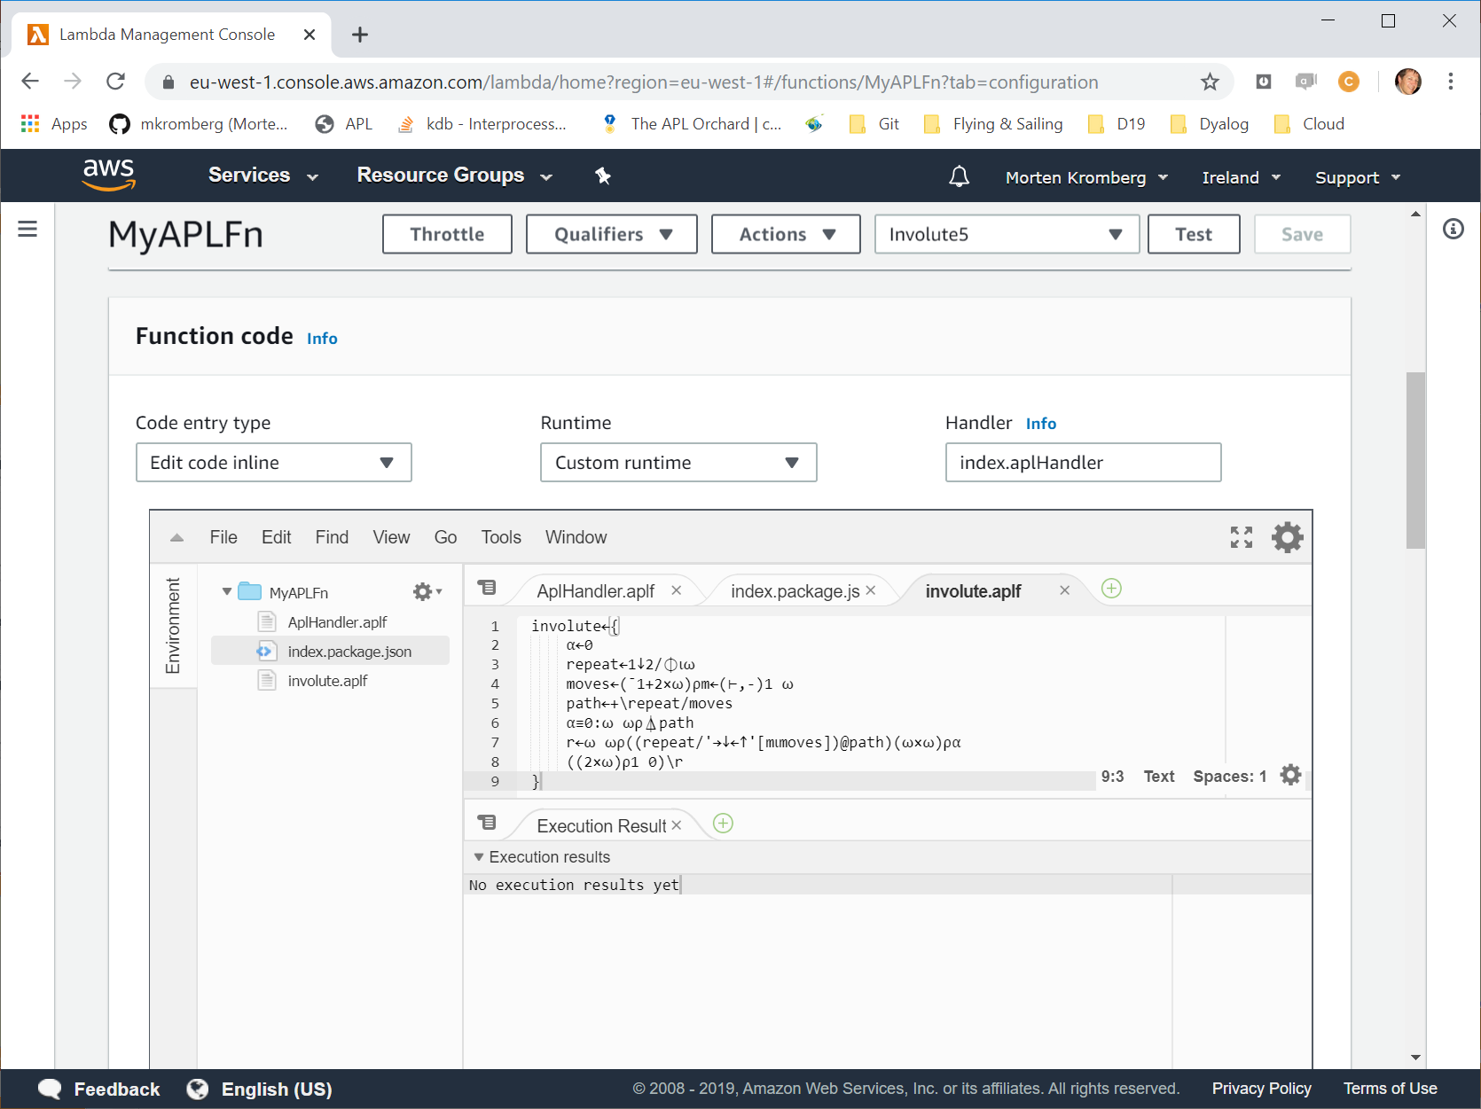

Slide 25
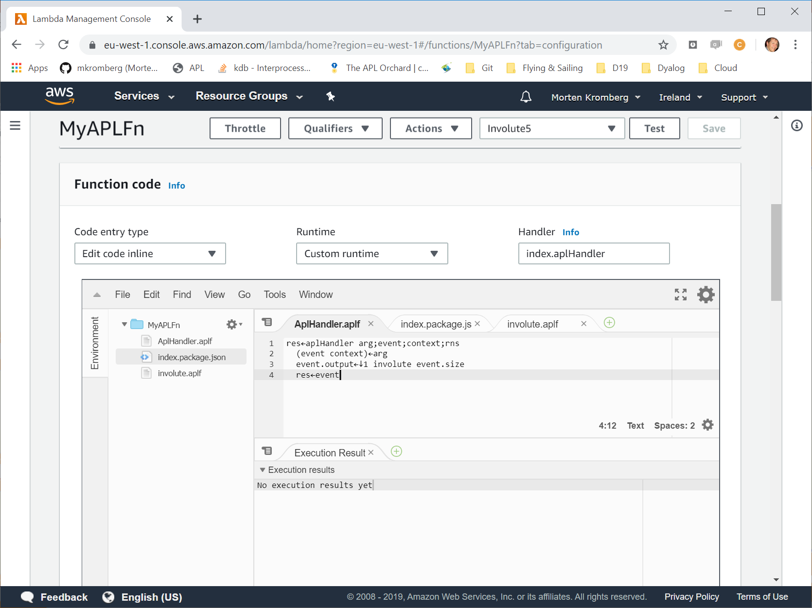

Slide 26
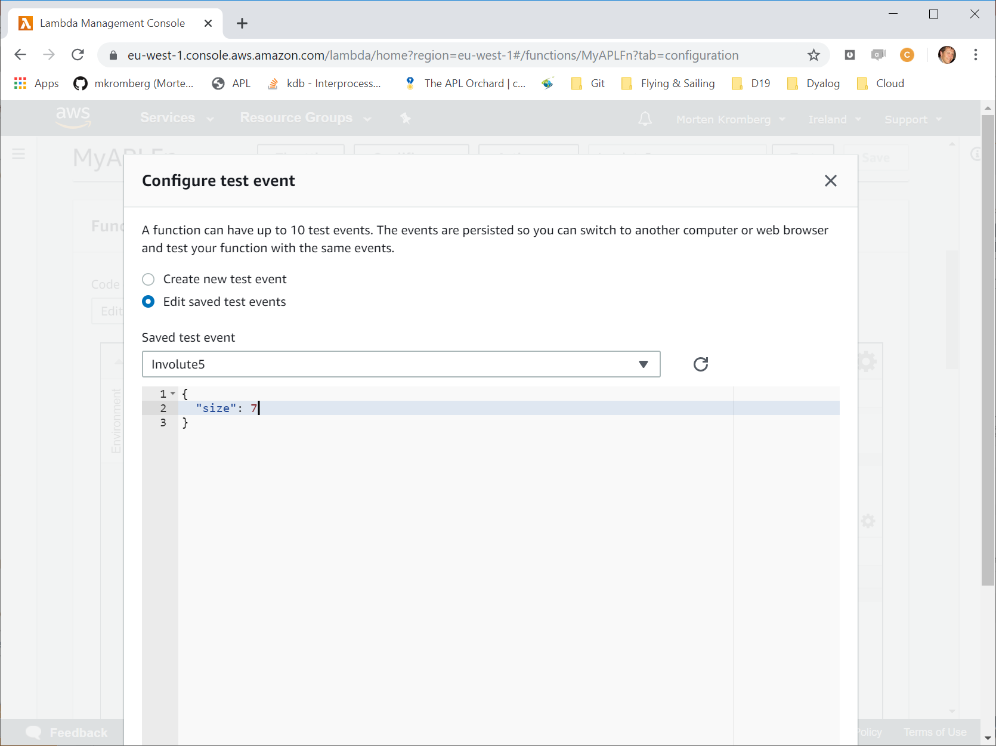

Slide 27
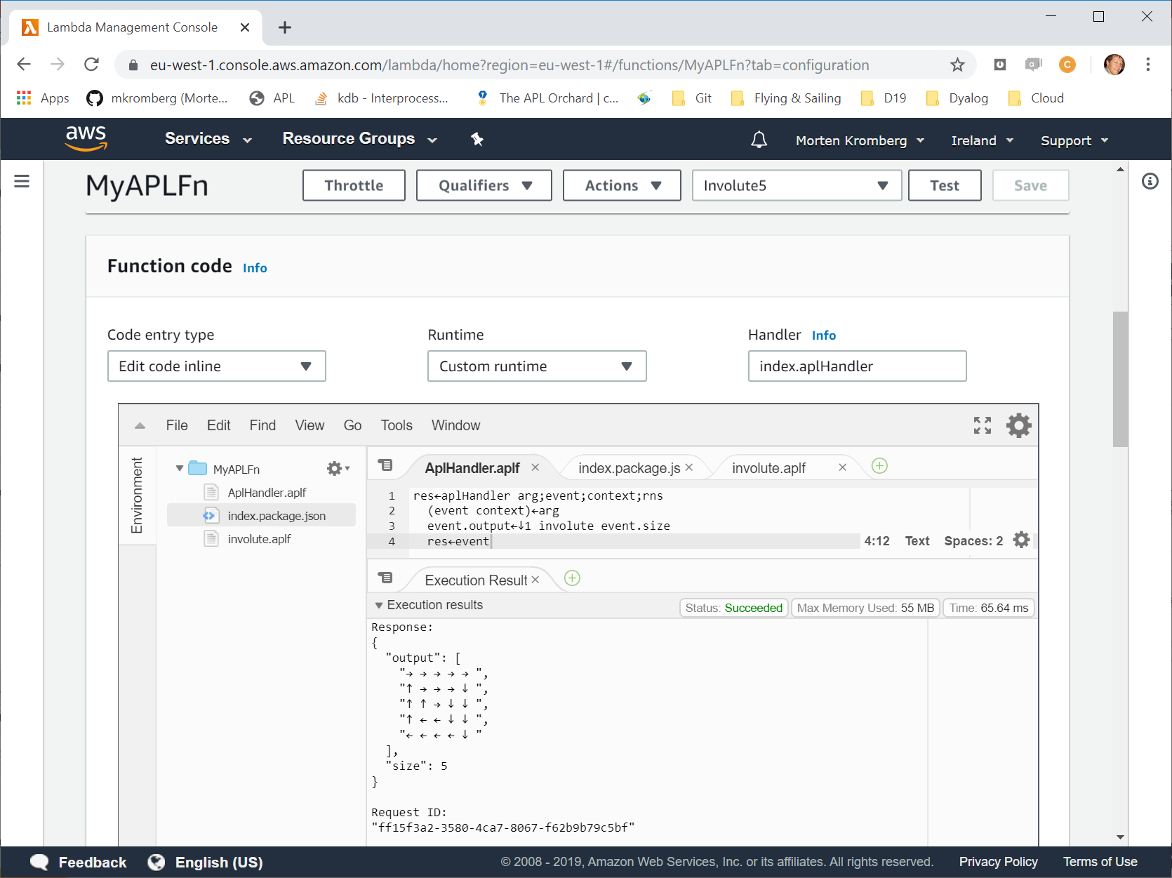

Slide 28
7 Deployments in 7x5 minutes
Full Stack in APL
Interactive APL Session
Win32 GUI "Stand Alone Executable"
Cross-Platform GUI (Desktop or Web)
Embedded APL Components
Shared Library (called from Python)
Microsoft.NET Assembly (called from PowerShell)
Services
Web Service in Docker Container (called from curl)
Serverless Lambda (Amazon Web Services)

Slide 29
Some Deployments NOT Demonstrated
COM/OLE Server
Similar to .NET Assembly
Allows e.g. Excel add-ins implemented in APL
Microsoft.NET also allows e.g.
Dyalog APL as an ASP.NET language
SharePoint components
WCF etc etc etc
Bi-directional Python Bridge
https://github.com/dyalog/pynapl

Slide 30
Deployments "To Come"
Microsoft.NET 5.0 / Core / Integration under Linux and macOS in addition to Windows
Coming in 2020 with Dyalog version 18.0
Proper support for the APL Interpreter as a "scripting" component (Hash Bang)

Slide 31
Acknowledgements
Marko Vranic at SimCorp A/S for the Serverless Dyalog APL Layer.
https://github.com/mvranic/apl-lambda

Slide 32

Next Steps...
Download Dyalog APL for non-commercial use under Windows, macOS, Linux (Intel & ARM).
https://www.dyalog.com/download-zone.htm
NB: Registration no longer required!
All the code and the demo scripts from this talk are available at
https://github.com/mkromberg/deliverapl
Online REPL + links to resources https://tryapl.org
StackExchange
https://chat.stackexchange.com/rooms/52405/the-apl-orchard

